Slide 1

Cipher Dossier
Batch No: B-10 Project Guide:
SAI SRIDIVYA I (164G1A0590) Mr. G. Hemanth Kumar Yadav M.Tech,(Ph.D)
SAJIDA S (164G1A0592) Assistant Professor
SKANDHA D (164G1A0599)
SREE VENI D (164G1A05A2)
Github Link :
Srinivasa Ramanujan Institute of Technology
Department of Computer Science & Engineering

Slide 2
Contents
Abstract
Introduction
Existing System
Problem Statement
Proposed System
Module Description
Use Case & Sequence Diagrams
Output Screens
Conclusion
References

Slide 3
Abstract
This project allows users to store sensitive data on their mobile phone without having to worry about confidentiality even if the mobile is lost.
This project concentrates on securing data on mobile phones by storing it in encrypted form using AES algorithm.
Even if user loses his mobile phone he can access his sensitive data by login to the system using other mobile phone.
User can access this system anywhere at any time he just has to use his user ID and password to access the system.

Slide 4
Introduction
Security of data is becoming an important factor for a wide spectrum of applications.
New vulnerability results from unique characteristics of mobile devices. Resistance against known attacks is one of the main properties that an encryption algorithm needs to provide.
To cope up with a mobile application is created where data is encrypted and stored in the cloud. So, if the mobile is lost also the user of this application can be able to retrieve their data.

Slide 5
Existing System
The encrypted data is stored in smart phone memory which is then later used for accessing by decrypting the data.
In case of lost or theft of smart phone the unauthorized person can have access to the device and a technically proficient person can get an entry into data as encryption techniques are all present on the device itself.

Slide 6
Problem Statement
There will be important files, notes, contacts and messages that need to be secured from intruders.
Also, if the mobile is lost which consists of this data that is important they can not be retrieved.
As a solution to this problem, a mobile application is created where a user can login into the application and can be able to store all the data which will be encrypted with the key given by the user using AES algorithm.

Slide 7
Proposed System
In the proposed system, the encrypted data is stored in the cloud platform. For this, the user has to login into the mobile application which is then later used for accessing by decrypting the data.
In case of lost or theft of smart phone, the user can login again from any mobile into this application using their credentials and can access the data that is stored in the cloud platform.

Slide 8
Module Description
Step 1: Register into application
Step 2: After successful registration, login into the application
otherwise repeat step1.
Step 3: Set keys for Contacts/Messages/Notes/Files.
Step 4: Add Contacts/Messages/Notes/Files into application.
Step 5: Upload the data in the application to the cloud.
Step 6: The user can view their data from any android mobile through this application by logging into it.

Slide 9
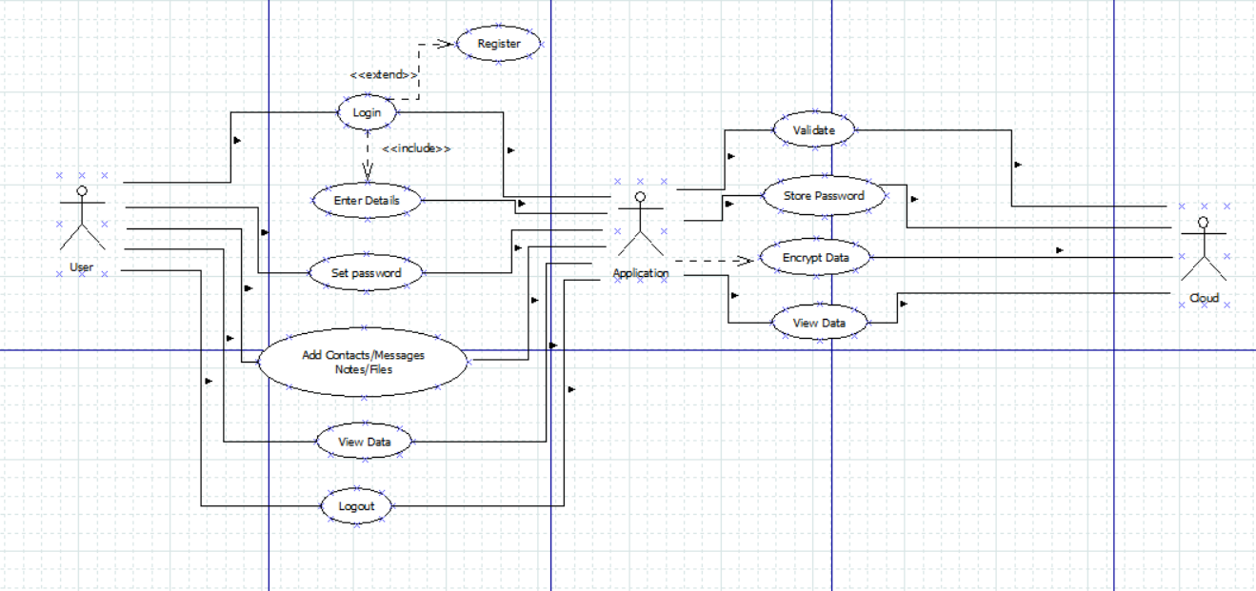
Use Case & Sequence Diagrams
Use Case Diagram

Slide 10
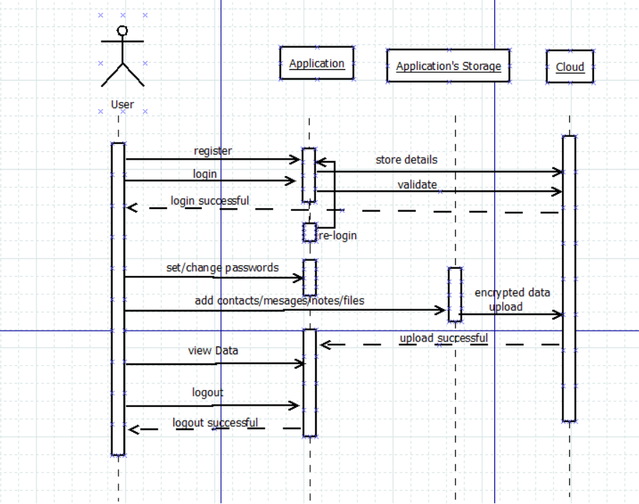
Contd..
Sequence Diagram

Slide 11
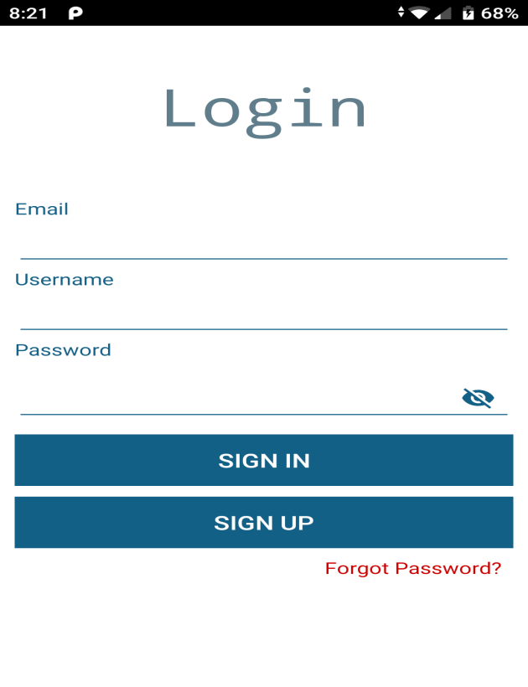
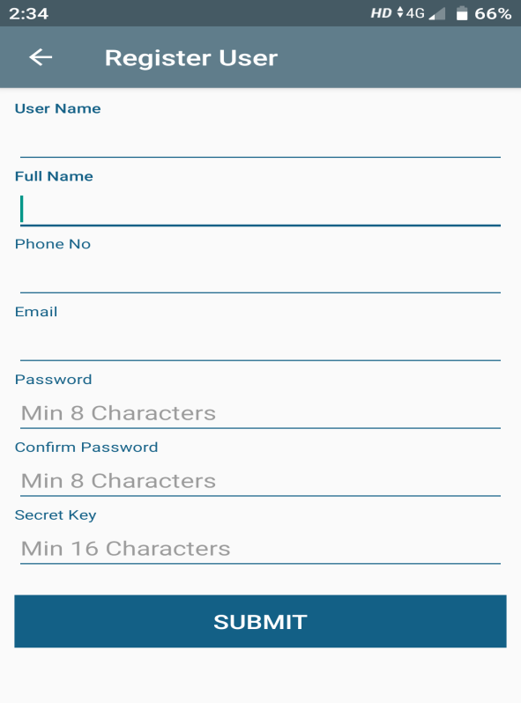
Output Screens
1:Login Page of application 2:Registration Page of application

Slide 12
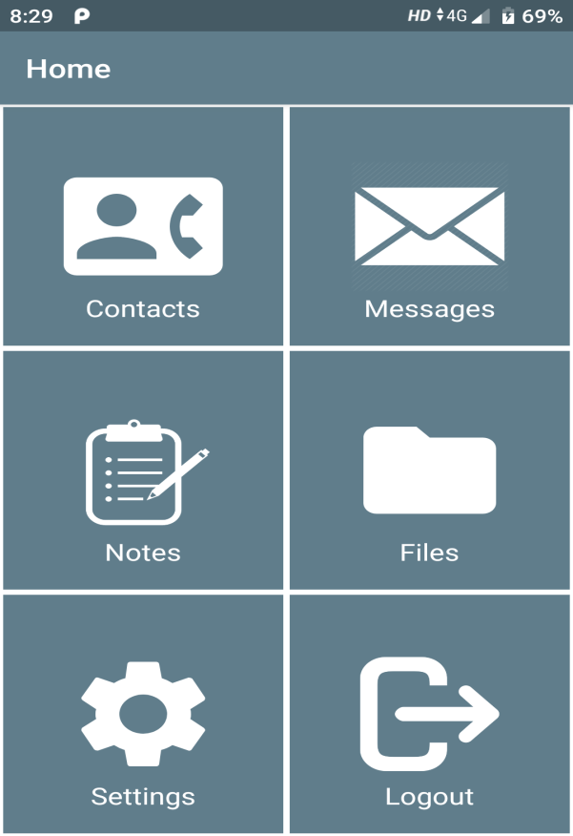
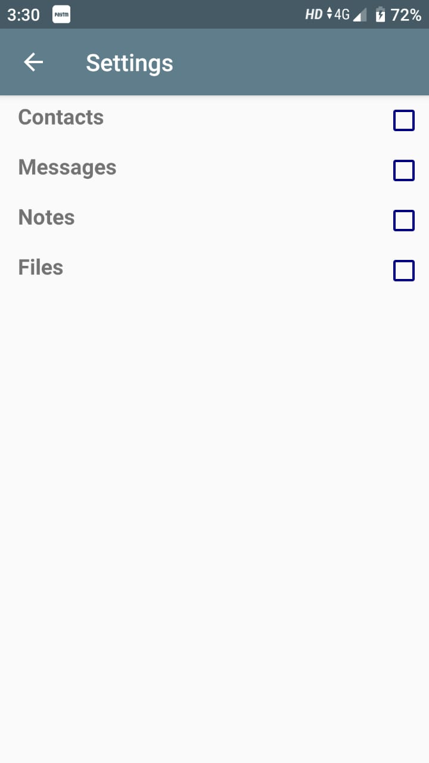
Contd..
3:Home Screen of application 4:Settings Activity to set keys

Slide 13
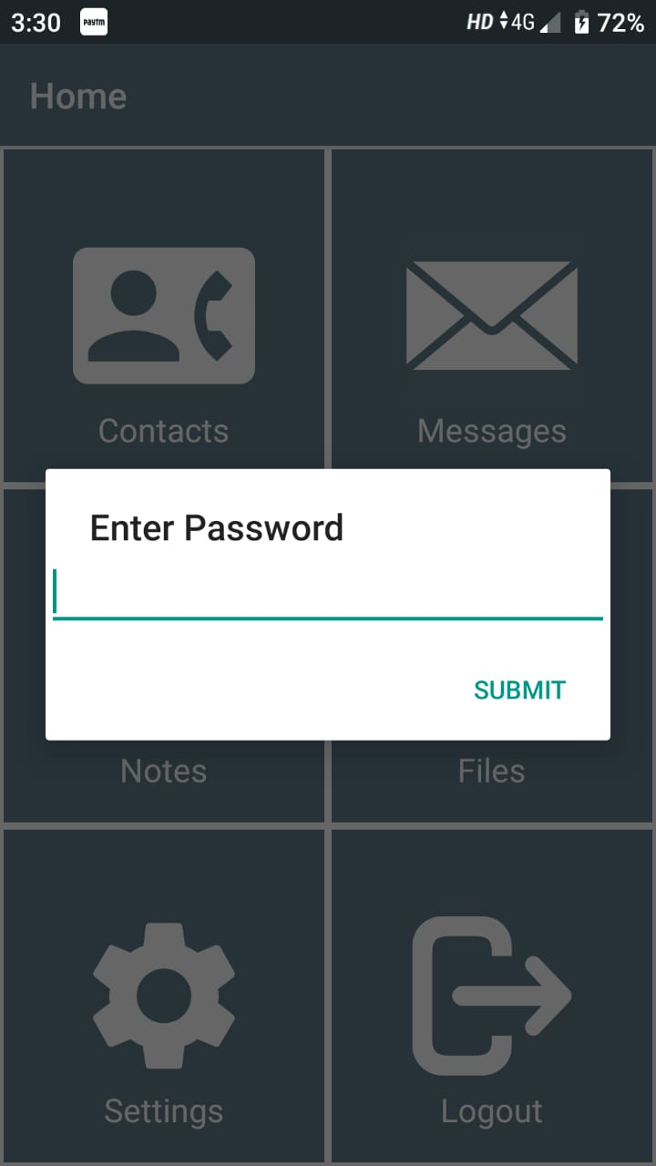
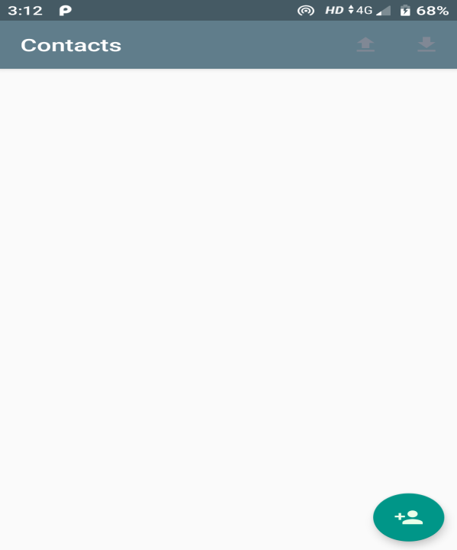
Contd..
5:Entering Key 6:Contacts Activity

Slide 14
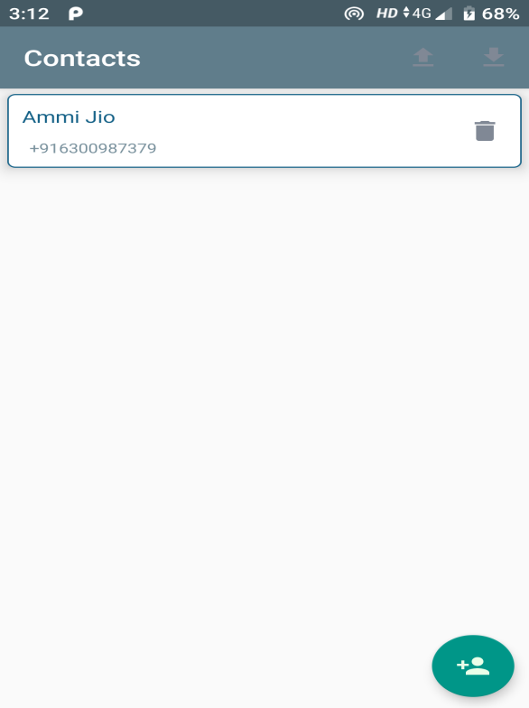
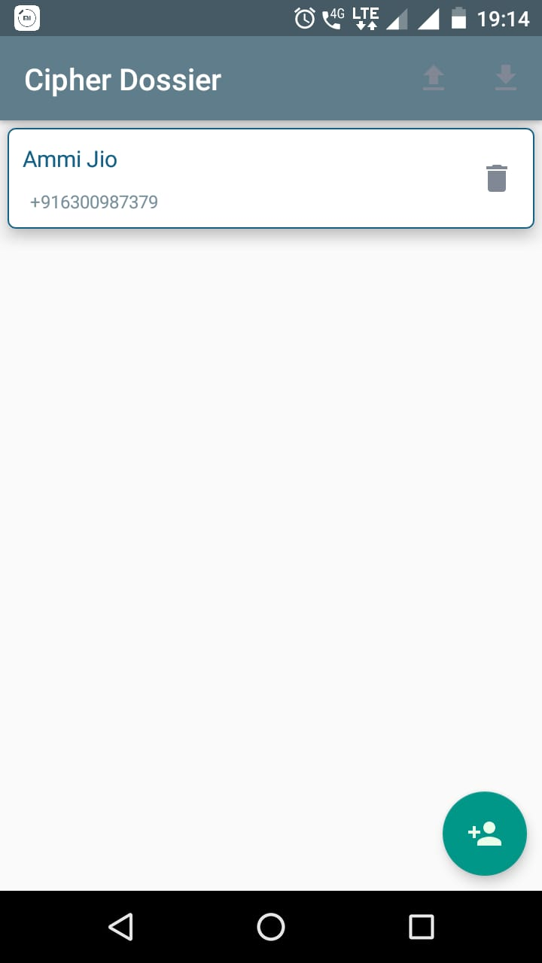
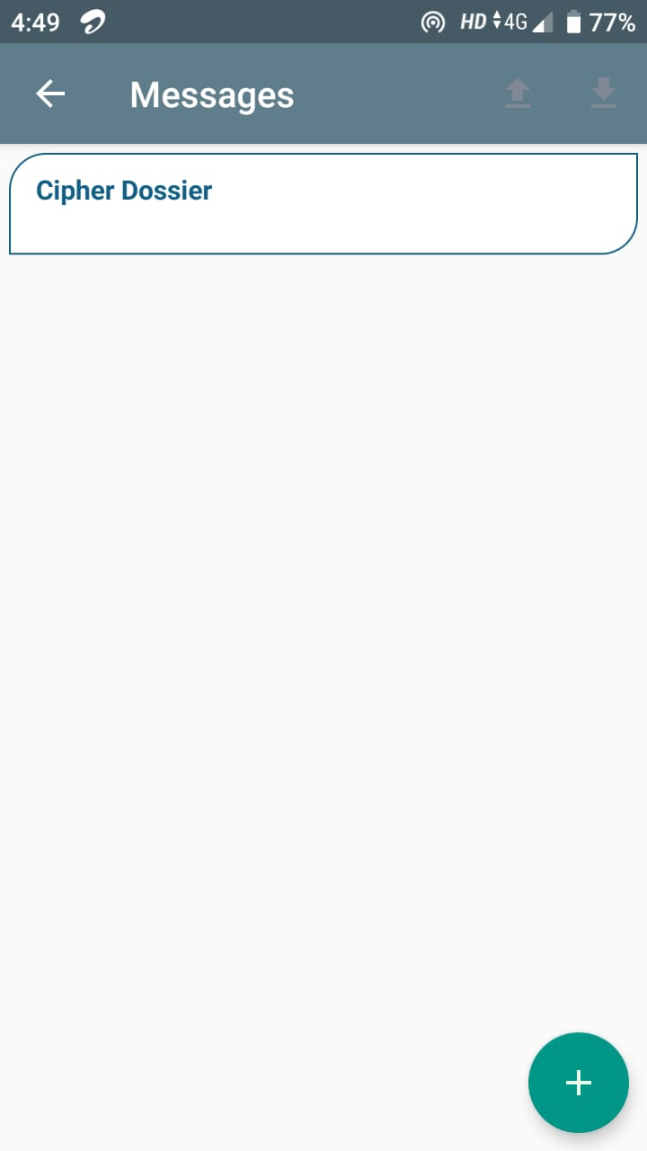
Contd..
7:Contacts Activity after 8:Accessing contacts in 9:Messages Activity after
adding contact another mobile adding message

Slide 15
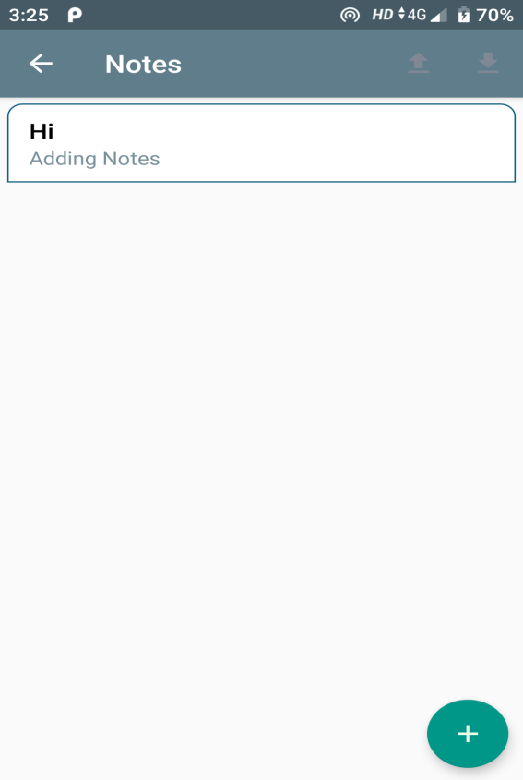
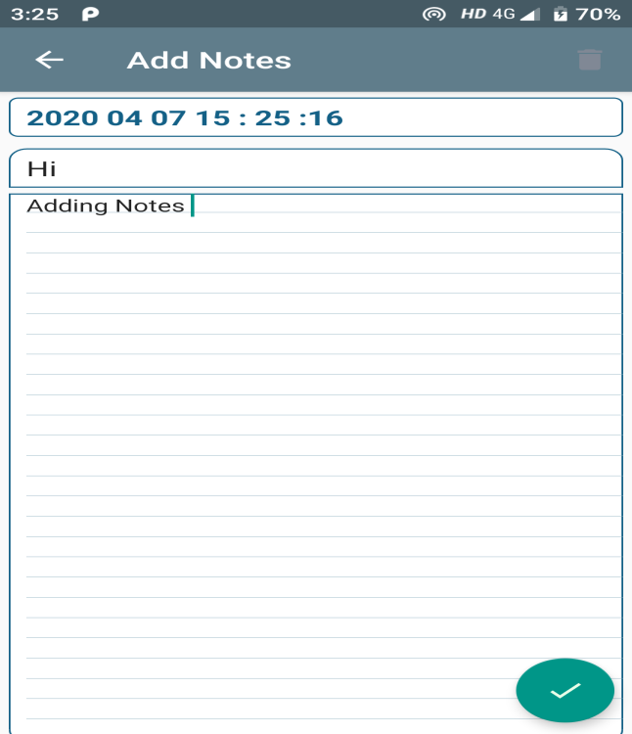
Contd..
10:Notes Activity 11:Adding Notes

Slide 16
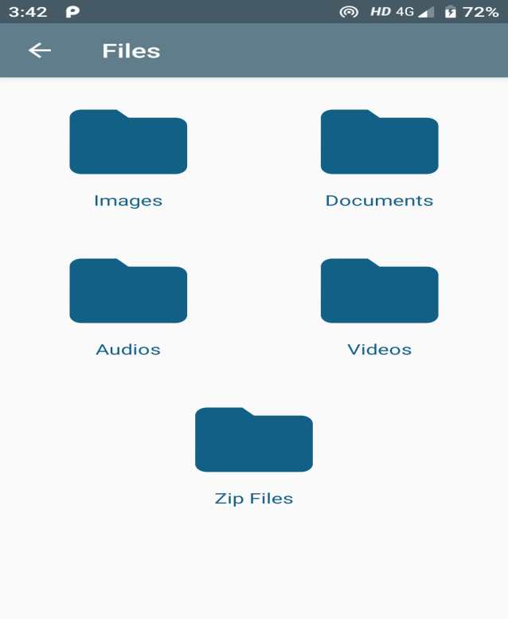
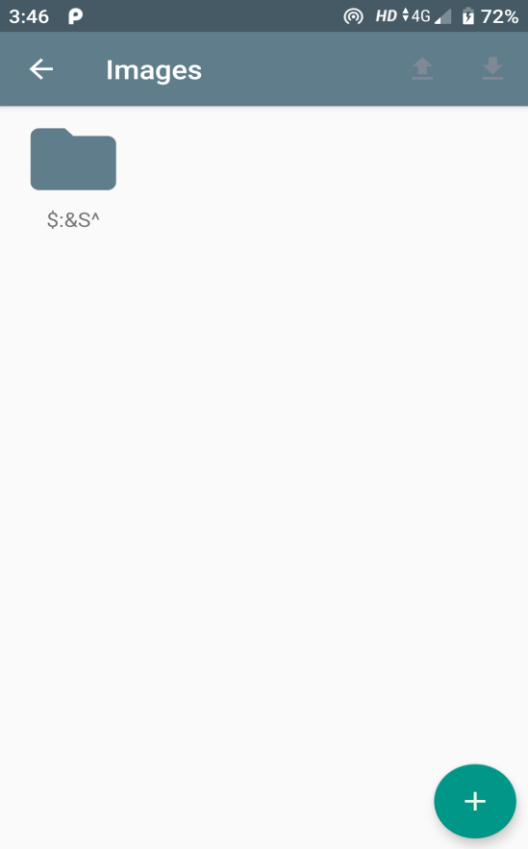
Contd..
12:Files Activity 13:Images Activity after
adding Image

Slide 17
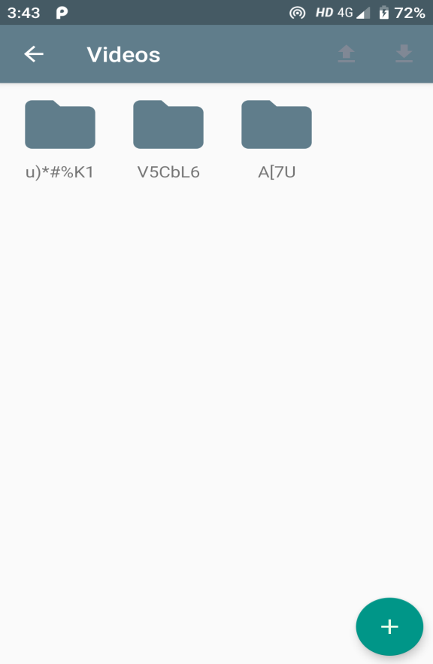

Contd..
14:Videos Activity after 15:Audio activity after
adding Videos adding audio file

Slide 18


Contd..
16:Documents Activity after 17: Zip files activity after
adding document adding a zip file

Slide 19
Conclusion
The application mainly concentrates on mobile phones and efficiently handles the situation when a mobile is lost and when there is no way to retrieve the data.
The user has to login with their credentials and set a key so that data will be encrypted and stored in the cloud.
The data can be accessed from any android device by logging into the application with their credentials.

Slide 20
References
[1] Ako Muhamad Abdullah. (2017). Advanced Encryption Standard (AES) Algorithm to Encrypt and Decrypt Data.
[2] Vichare, A., Jose, T., Tiwari, J., & Yadav, U. (2017). Data security using authenticated encryption and decryption algorithm for Android phones, 2017 International Conference on Computing, Communication and Automation (ICCCA). doi:10.1109/ccaa.2017.8229903.
[3] Mitesh Parmar, Summedh Kharat, Nilesh Palve, Chetan deokate, Prof. Yogesh shahare, Mobile Self Encryption Techniques, International Journal for Research in Engineering Application & Management (IJREAM), 12 March 2018.

Slide 21
Thank you
Queries
?

